Slide 1

Exploratory Data Analysis
Paul Sabin, Code Academy Berlin
9 November 2023

Slide 2
Contents
01
02
03
Introduction
Goal
Analysis
04
05
06
Imbalance
KPIs
Key takeaways
Keep the system in balance
When and where do people ride?
Causes and remedies
To measure system balance

Slide 3
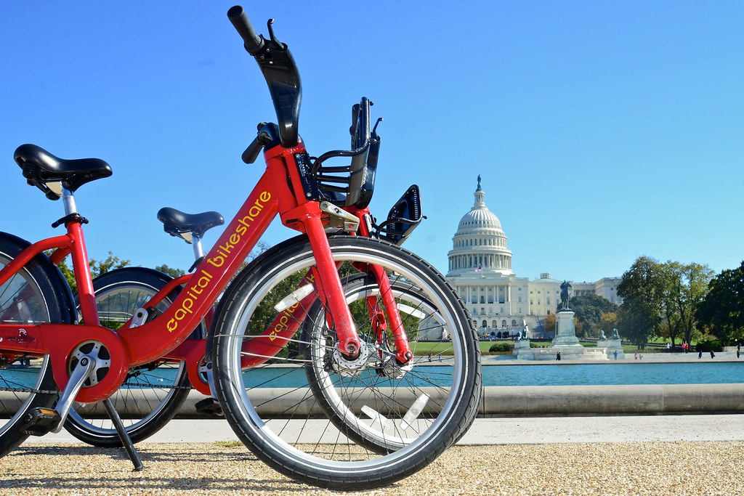
01
Introduction

Slide 4
About Capital Bikeshare (CaBi)
PPP
Broad goals
Docked bikes
Public-private partnership between municipal owners and Motivate (Lyft)
Transportation Community Quality of Life System Sustainability*
Classic bikes & docks
New: e-bikes
Data on rides
4
*Source: District Department of Transportation (DDOT), Development Plan
Notes:
1) Motivate is operator. Plays important role in maintaining system health and availability. Each jurisdiction contracts out with Motivate to run the system in exchange for a fixed fee per dock. M was acquired by Lyft in 2018. Since that time Lyft has integrated CaBi into the Lyft app.
2) More than just mobility, and certainly more than just generating profit. 4 Themes:
3) As opposed to more recent dockless mobility options such as scooters and other bikes. E-bikes owned by Lyft.

Slide 5
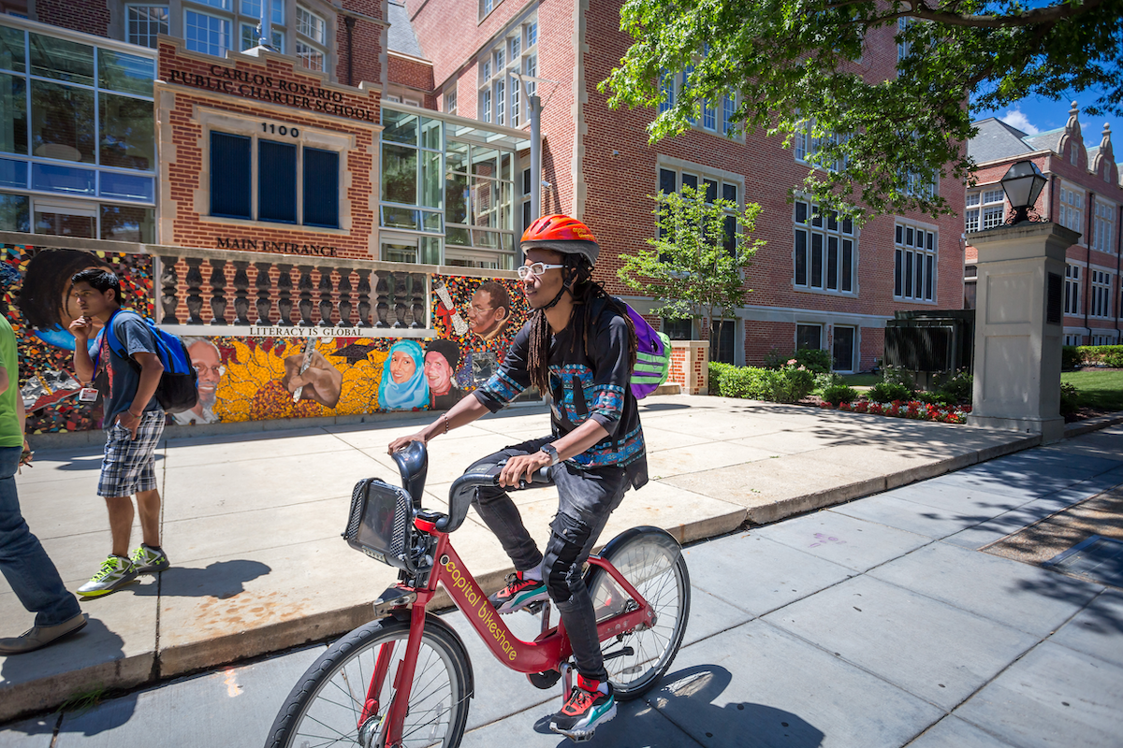
02
Goal: system balance

Slide 6
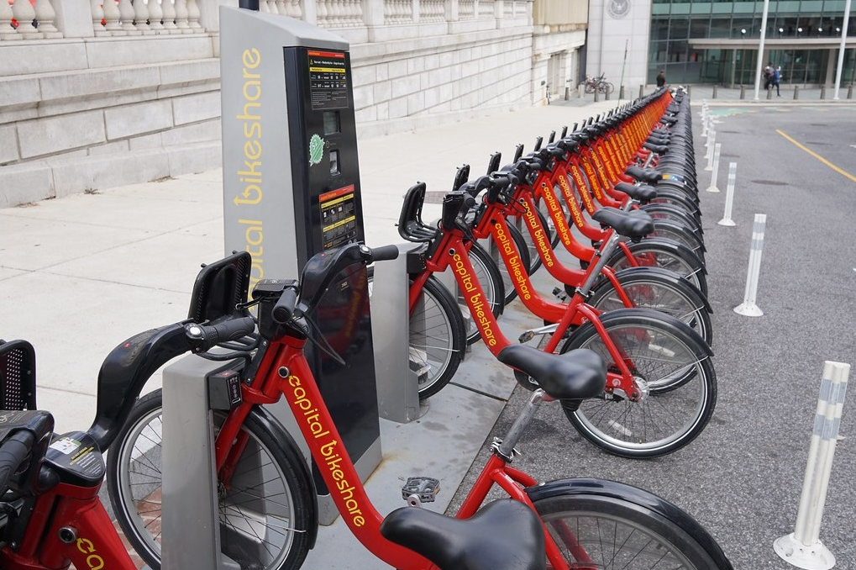
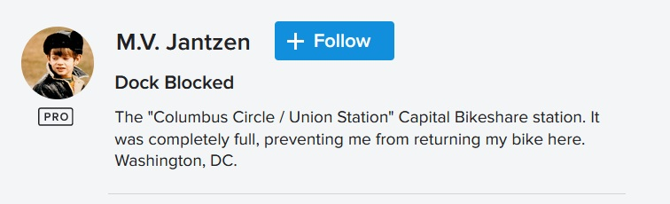
User experience: getting dock-blocked
2
Notes:
I feel I have to share this with you: I too have been dock-blocked. It happened to me many years ago in Lyon, in France. So I know the feeling! And the worst thing about getting dock-blocked is, you think you’ve reached where you want to be. You found your vehicle, you’ve navigated your way around the city, you’re just in time to arrive, you reach the station – and – all the docks are blocked. There is nothing more frustrating, especially if the next station is some distance away.

Slide 7
—CaBi User Survey 2016
“Fifty-five percent of respondents said they would ride more often if more docks/bikes were added to existing stations.”
3

Slide 8
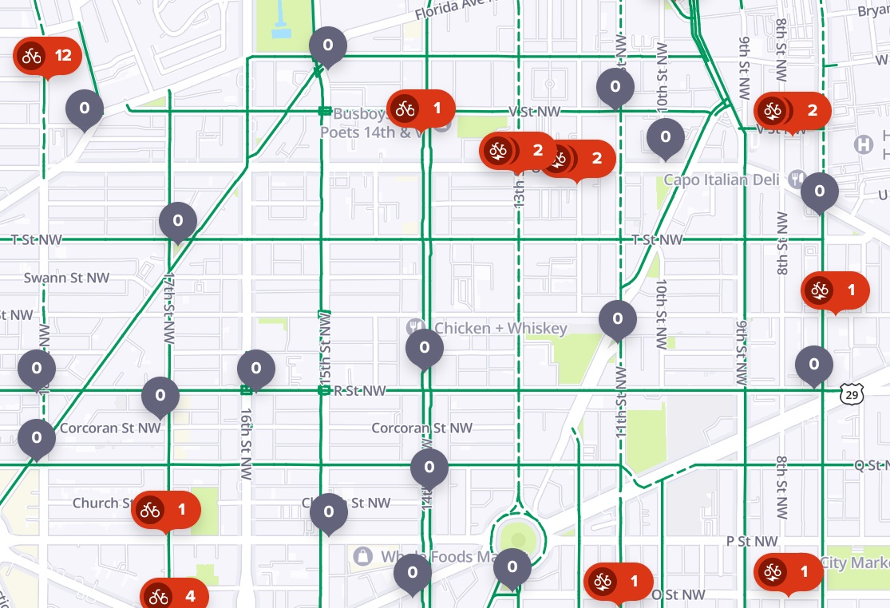
Empty stations – still a thing in 2023!
Live view, 10:30am Tuesday, near Logan Circle
4
Notes:
It’s not part of the data made publicly available, but CaBi clearly knows when stations are empty or full.

Slide 9
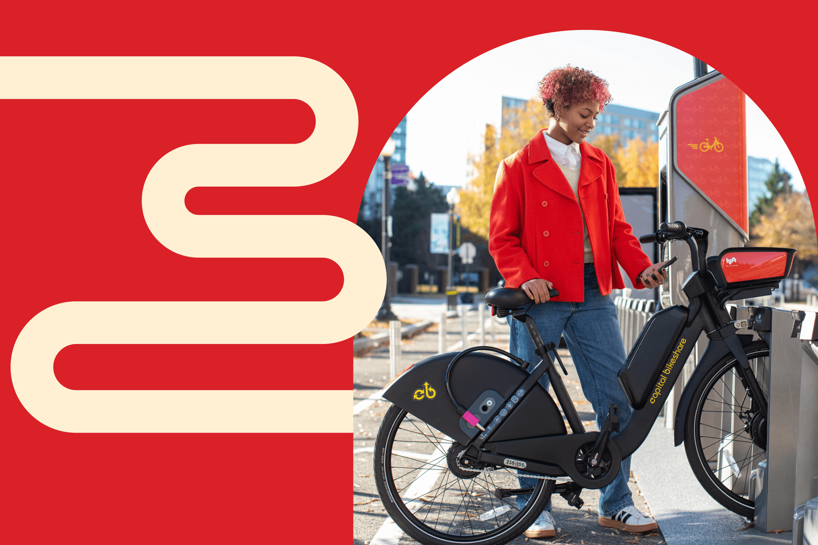
A balanced bikeshare system
For a convenient ride experience, users need:
Functioning bikes available nearby
Free docks at the destination
So we need to maintain balance in how bikes are distributed around the city.
5
Notes:
Let’s talk about balance [Slide]
What might cause a bikeshare system to lose its balance? There are numerous answers to this question, but here are two really big ones:
Many people wanting to ride at the same time
Many people wanting to start or end their ride at the same place

Slide 10
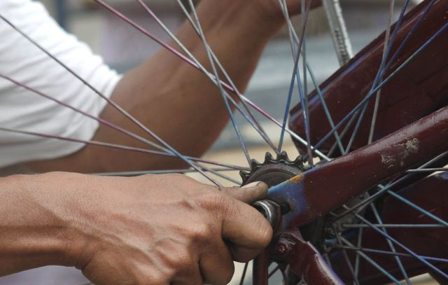
03
Analysis

Slide 11
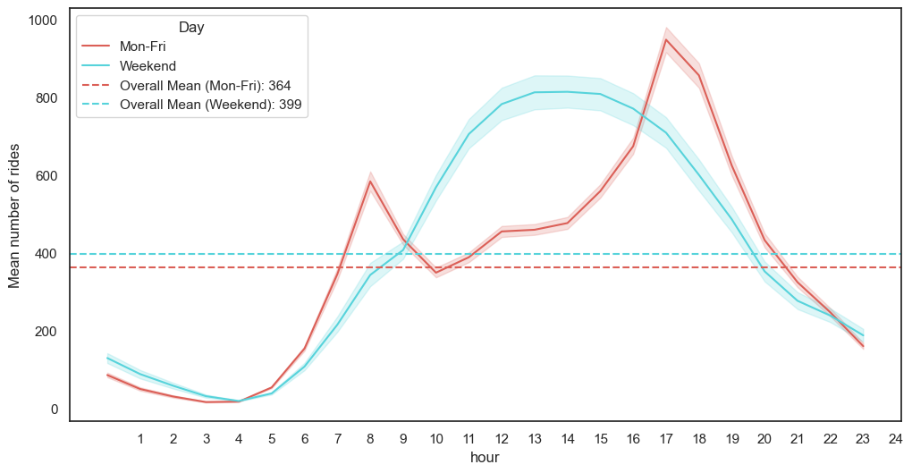
When do people ride?
Weekdays
Commuter peaks 6:00 - 9:00 and 16:00 - 19:00
Weekends
More evenly throughout the day
6

Slide 12
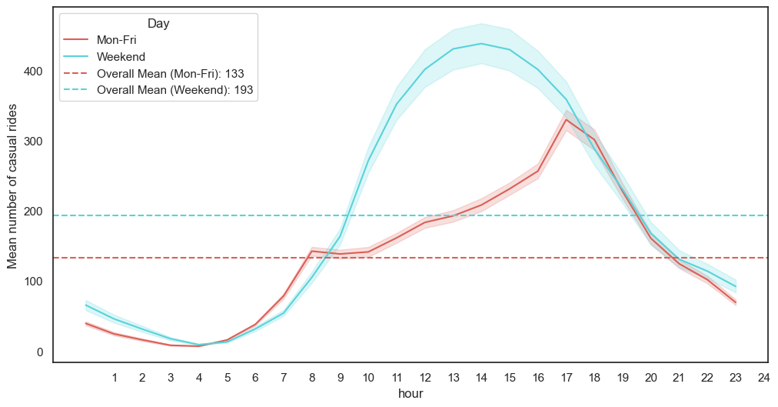
Is is different for casual users?
You bet!
Weekend use is 45% higher than weekdays
Small peaks
At commuting times
7

Slide 13
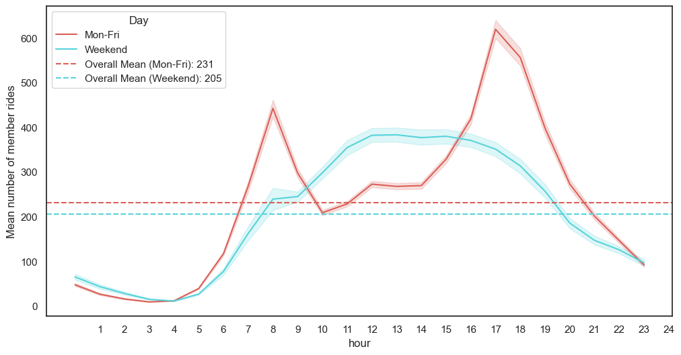
How about members?
+ Weekdays
Member use is 13% higher from Mon-Fri
High peaks
Commuting times are especially busy
8

Slide 14

Where are people going?
Data needs reorganising:
6,157,609 classic bike rides over 911 days
How are these spread across 818 stations?
9
Notes:
To find out where people tend to ride to and from, I aggregated the ride data by station. That involved creating a new dataframe with stations as the rows, counting up the rides that started and ended there, and adding some extra features to let me know how well balanced each station is.
To give you an example, I’ll start by comparing a couple of specific stations.

Slide 15
Balanced: New Hampshire Ave & T St NW
Daily usage
Work am
Work pm
TOP! 159 bikes taken/returned at 22 docks
-12.9 bikes
+12.5 bikes
Bikes added
Fun am
Fun pm
49.7%
-6.3 bikes
+4.2 bikes
10
Notes:
“Work” = Monday-Friday, “Fun” = Saturday & Sunday

Slide 16
Balanced: Columbus Circle/Union Station
Daily usage
Work am
Work pm
146 bikes taken/returned
at 50 docks
+8.59 bikes
-5.66 bikes
Bikes added
Fun am
Fun pm
50.3%
+8.4 bikes
-12.17
11
Notes:
It’s a destination for riders in the morning and a start point for riders in the afternoon. So it appears that people use the main train station to travel outside the city for the day and come back in the afternoon. Both on workdays and weekends.
The figures are somewhat unbalanced during the week, but the weekend figures redress the balance. This is one of my favourite bike stations in DC because, like the diligent workers of the city, it uses weekend activities to balance out the working week.

Slide 17
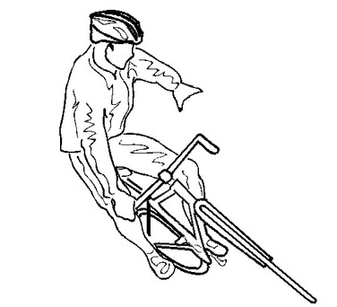
04
Imbalance

Slide 18
Unbalanced: Columbia Rd & Georgia Ave NW
Daily usage
Work am
Work pm
28 bikes taken/returned at 26 docks
-6.0 bikes
-1.8 bikes
Bikes added
Fun am
Fun pm
37.1%
-4.2 bikes
-1.9 bikes
12
Notes:
Go through – focus on bikes added.
Audience: If people are taking bikes from here to commute to work or have fun at the weekend, why are fewer bikes being returned in the afternoon?
You may be also asking: How is that even possible? It has 26 docks. If it keeps losing bikes at these rates, after 4 days it’s empty, there are no more bikes left to take. The answer is: rebalancing. Measures are in place to redistribute bikes around the city. Motivate picks up bikes in trucks to bring them to empty stations. In addition, a Corral Service means staff are on hand at busy stations at peak times to remove bikes when docks are full. Commute destinations & special events.
Why do some stations lose their balance?

Slide 19
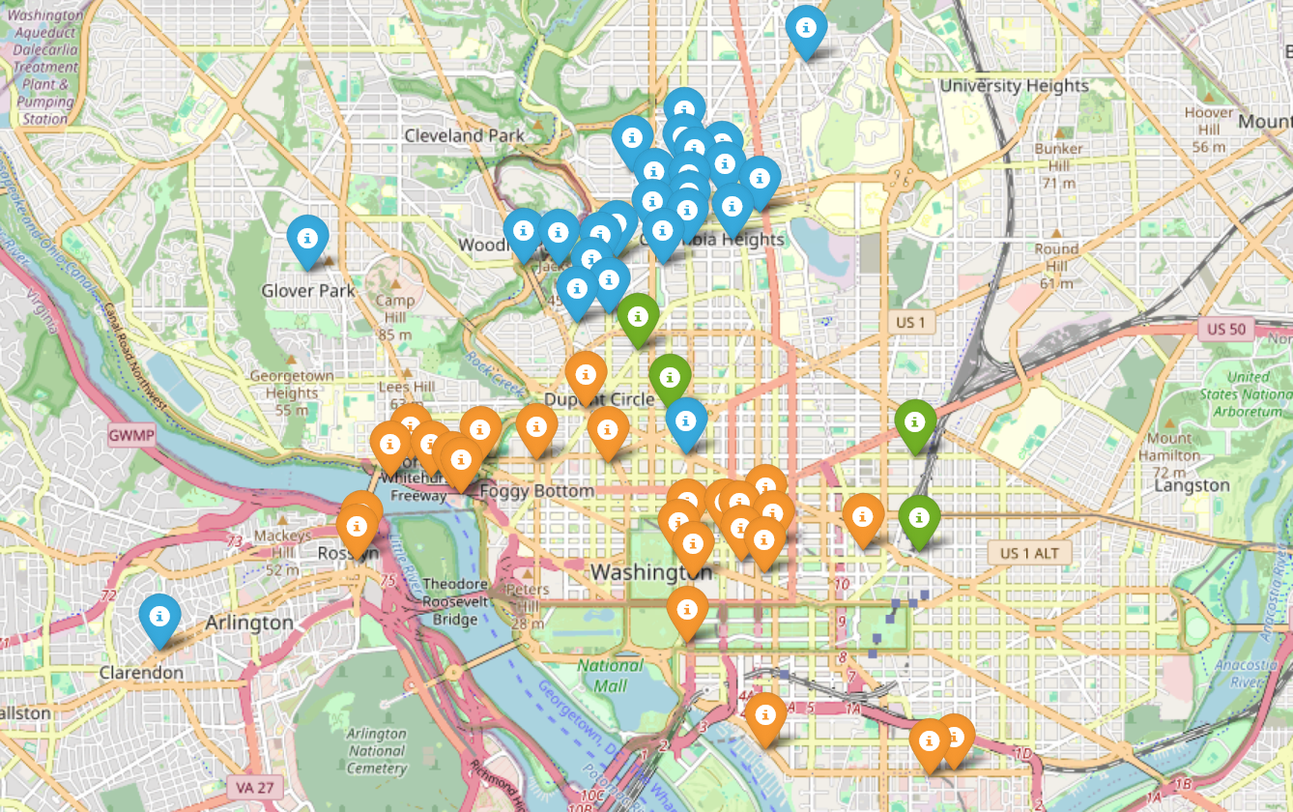
Notes:
To find out, I plotted the top 40 most unbalanced stations on a map of DC. That means, the stations with the largest net difference between bikes taken and bikes returned. The blue dots on the map are the stations that lose the most bikes over the course of a day. The orange dots are stations that gain the most bikes. The green dots are the small selection of well balanced stations we looked at previously.

Slide 20
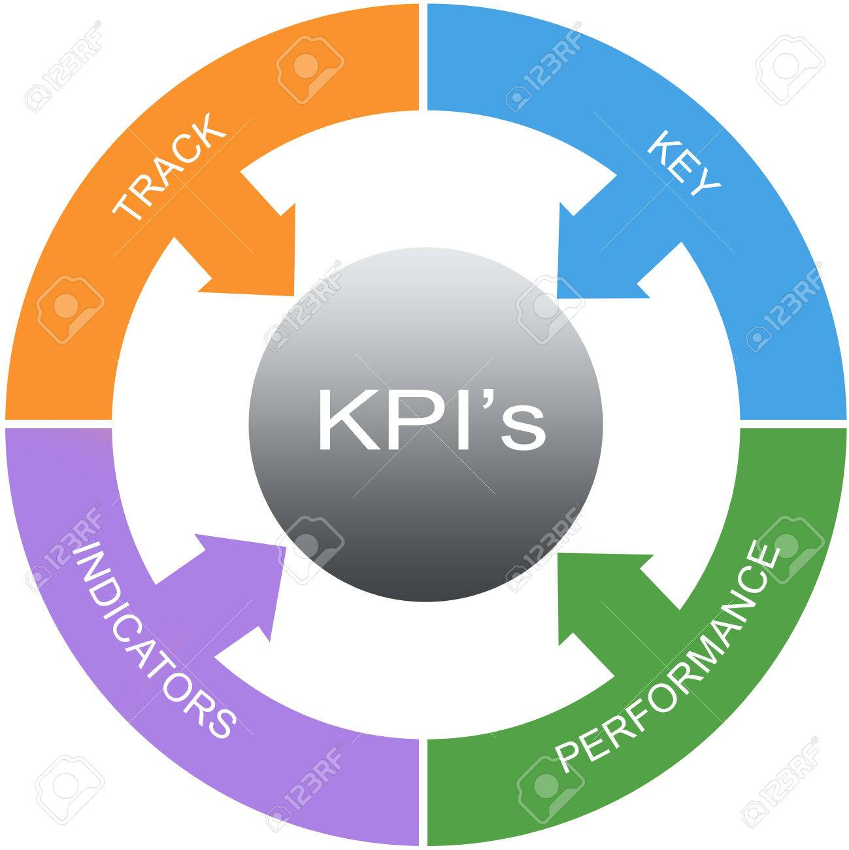
05
KPIs
Notes:
So what can we do to help the system stay in balance? I’d like to answer that question by looking at 2 recommended KPIs for Capital Bikeshare.

Slide 21
Recommended KPIs
1) Reduce station downtime
2) Increase Bike Angel rides
Measured by length of time per month that a station is completely full or empty.
CaBi goals: transportation, system sustainability.
Responsibility of Motivate – corrals and rebalancing trucks
Use data analysis to target the most popular unbalanced stations.
Measured by number of Bike Angel rides per month compared to prior year.
Also serves CaBi goals of community, quality of life.
How? Raise program visibility, offer attractive rewards.
Target less popular unbalanced stations.
13
Notes:
Motivate: Corrals to cope with peak-time dock demand & moving bikes by truck
Bike Angels is a programme that members can sign up for to receive points and rewards by moving bikes from full to more empty stations.
Community: enhances feeling of belonging, more than just a consumer service. Quality of life: this an opportunity to get some vigorous exercise, for example by riding the uphill journey home from work.

Slide 22
—User on Bike Arlington Forum, 2020
“Rebalancing laps can be a fun way to earn a few Angel points and get some multimodal exercise.”
14
Notes:
“I've found Courthouse to be a great spot for it because bikes will often accumulate at some stations just a few blocks from other empty stations. Unsurprisingly, the full stations are always at lower elevations than the empty ones, so you will be jogging downhill and riding uphill.”

Slide 23
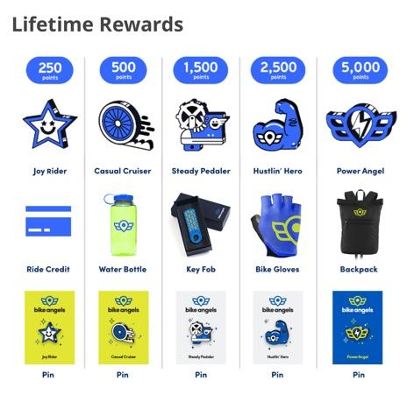
Bike Angel rewards
Choosing the right rewards:
Encourage identification with CaBi
Further boost visibility & engagement
Make it worthwhile!
15

Slide 24
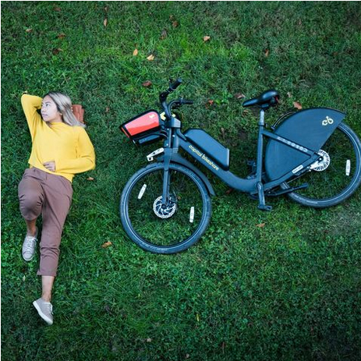
06
Key Takeaways

Slide 25
Key Takeaways
Downtime
Topography
Bike Angels
Means fewer rides and frustrating user experience
Major driver of station imbalance
Alongside operator measures to rebalance system & serve broader goals
16

Slide 26
Thanks
Any more questions?
paul@sabinwords.com
Please keep this slide for attribution

Slide 27
Research references
District Department of Transportation (DDOT), Development Plan Update 2020
http://bikearlingtonforum.com/

